Slide 3
Romans 3:21-26

Slide 4
²¹ But now the righteousness of God has been manifested apart from the law, although the Law and the Prophets bear witness to it— ²² the righteousness of God through faith in Jesus Christ for all who believe. For there is no distinction: ²³ for all have sinned and fall short of the glory of God,

Slide 5
²⁴ and are justified by his grace as a gift, through the redemption that is in Christ Jesus, ²⁵ whom God put forward as a propitiation by his blood, to be received by faith. This was to show God’s righteousness, because in his divine forbearance he had passed over former sins. ²⁶ It was to show his righteousness at the present time, so that he might be just and the justifier of the one who has faith in Jesus.

Slide 7
The wrath of God is being revealed...
...because humanity have turned their back on God.
Godlessness / Idolatry
A Downwards Spiral
Unrighteousness / Immorality / Depravity
Jews & Gentiles alike, are under SIN
The wrath of God – handed over to all manner of unrighteousness
homosexuality
a debased mind
Evil
covetousness
depravity
envy
murder
strife
deceit
maliciousness
gossips
slanderers
haters of God
insolent
haughty
boastful
inventors of evil
disobedient to parents
foolish
heartless
ruthless
“The day of wrath” is coming – The Lord will require a reckoning

Slide 8
If all have sinned – All have fallen short of the Glory of God, on judgment day, because God is Just, He has no option, but to condemn us....
BUT NOW :
There is an off-ramp

Slide 9
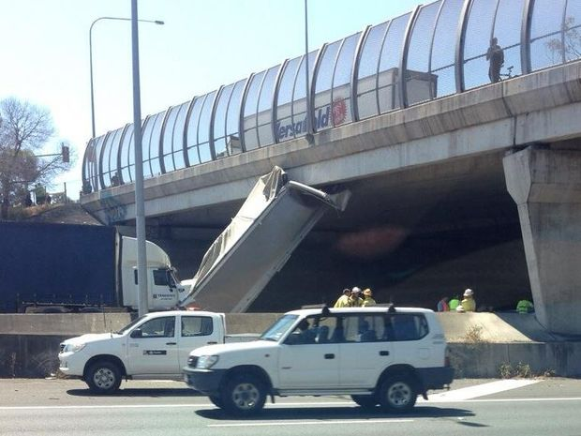

Slide 10
If all have sinned – All have fallen short of the Glory of God, on judgment day, because God is Just, He has no option, but to condemn us....
BUT NOW :
There is an off-ramp
God is not only “Just”... He also justifies those who have faith in Jesus Christ. He makes us righteous
justified by his grace as a gift, through the redemption that is in Christ
Redemption – We were slaves to sin, but now bought out of slavery
Righteousness – Only God is truly righteous. Only God can make us so.
Just – God is just, and so can’t just “let us off the hook”
Justified – For the judge to decide “Not Guilty”
Justifier – To make someone righteous...
God put Jesus forward as a propitiation by his blood, to be received by faith
English – Propitiation / Expiation Afrikaans – versoening
Greek – ἱλαστήριον (hilasterion)

Slide 11
If all have sinned – All have fallen short of the Glory of God, on judgment day, because God is Just, He has no option, but to condemn us....
BUT NOW :
There is an off-ramp
God is not only “Just”... He also justifies those who have faith in Jesus
Redemption – We were slaves to sin, but now bought out of slavery
Righteousness; Just; Justified; Justifier
God put Jesus forward as a propitiation by his blood, to be received by faith
English: Propitiation / Expiation / Atoning sacrifice Afrikaans: versoening
Greek – ἱλαστήριον (hilasterion)
Expiation – The demands of justice are satisfied (the debt is paid)
Propitiation – reconciliation – for wrath to be satisfied
to Greeks – described the way they appeased their vengeful Gods
in the Old Testament – the lid of the Ark of the Covenant (the Mercy Seat) – The place where blood was sprinkled for atonement – sins were paid for, and God’s righteous wrath was quenched

Slide 12
God put Jesus forward as a propitiation by his blood, to be received by faith
English: Propitiation / Expiation / Atoning sacrifice Afrikaans: versoening
Greek – ἱλαστήριον (hilasterion)
Expiation – The demands of justice are satisfied (the debt is paid)
Propitiation – reconciliation – for wrath to be satisfied
to Greeks – described the way they appeased their vengeful Gods
in the Old Testament – the lid of the Ark of the Covenant (the Mercy Seat) – The place where blood was sprinkled for atonement – sins were paid for, and God’s righteous wrath was quenched
In God’s mercy, Jesus is now the place where sins are paid for and God’s righteous wrath is satisfied
Before Christ, God didn’t pour our His wrath as we deserved
(an IOU to be paid at the cross)
Now the debt of sin is paid and the wrath of God is satisfied (in advance) For all those who have faith in Jesus Christ

